Slide 1
DEMO

Slide 2
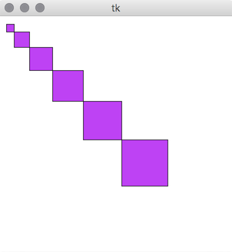
PurpleSteps 3D
Expectation:

Slide 3
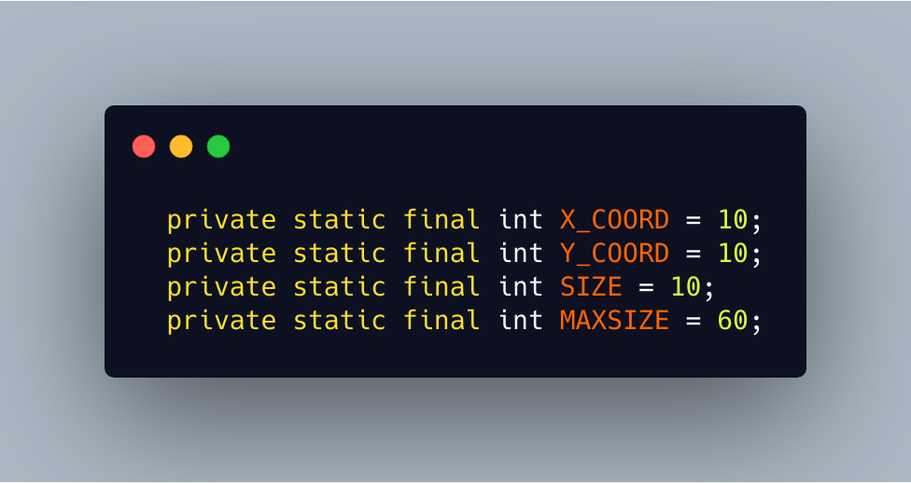
“MAGIC” NUMBERS

Slide 4
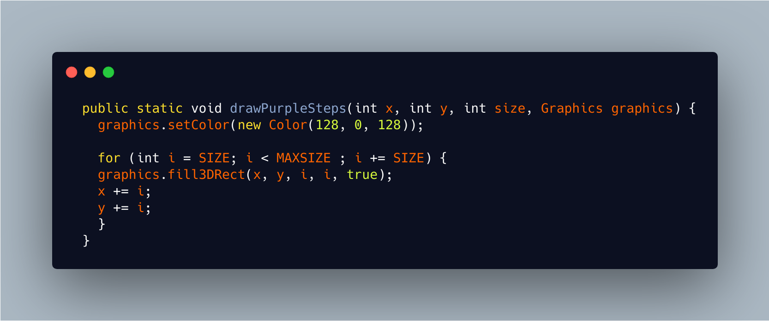
FOR LOOP

Slide 5
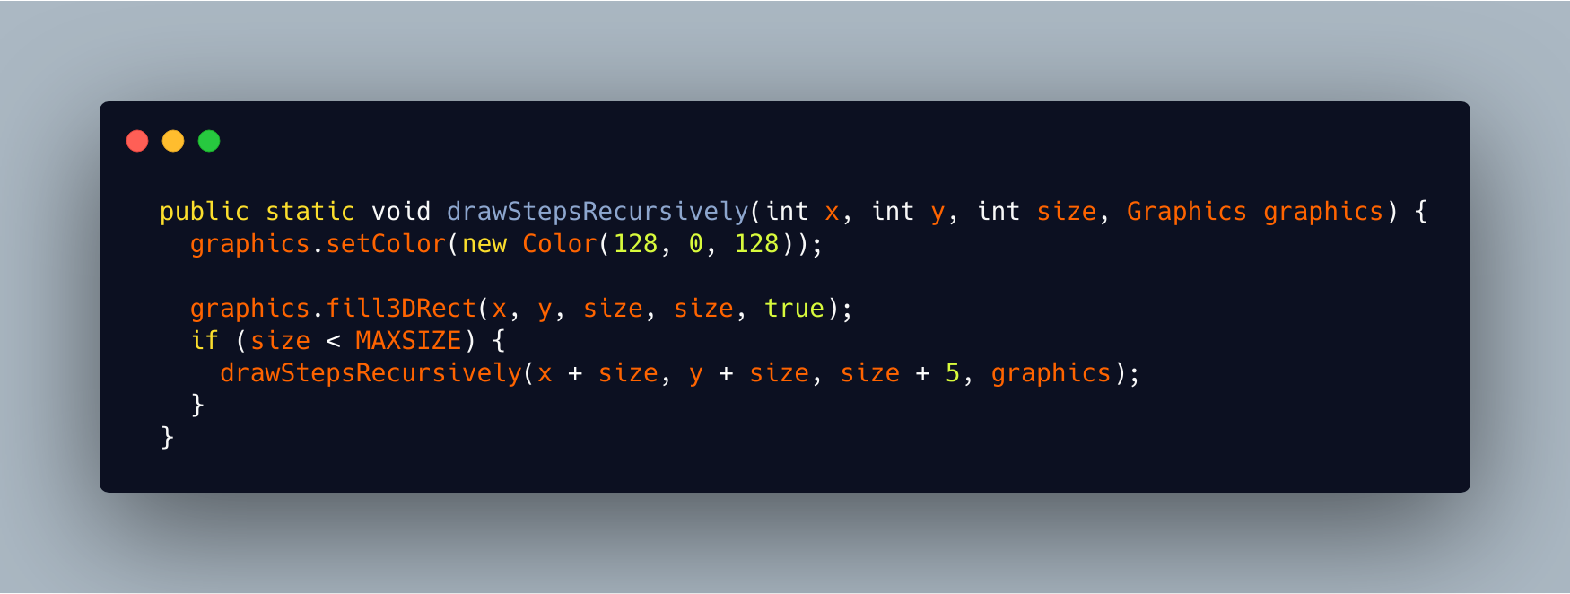
RECURSION

Slide 6
RUNNING TIME

